Slide 1
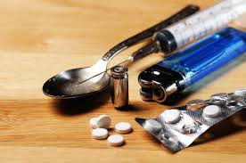
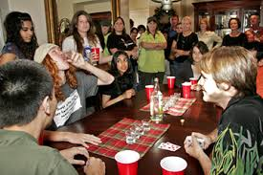
Be a Parent, Not a Friend: Current Trends and Signs and Symptoms of Substance Abuse

Slide 2
Agenda
Current Trends
Warning Signs
Resiliency building
What can I do to help my teen?
Resources in your community
Questions & Comments

Slide 3
Current Trends Among Our Teens
Marijuana Candy
Dabs (Marijuana)
Prescription Pills
Pharm Parties
Synthetic Drugs
Bath Salts
MDMA (Ecstasy)
Heroin
Alcohol
E-Cigarettes & Hookah

Slide 4
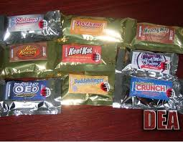
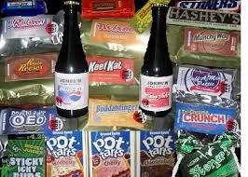
Marijuana Candy
Being seized in greater frequency in NJ & other states
Extremely dangerous because of its potency & because it is often disguised as hard or gummy candy or chocolate
May be branded & wrapped in commercial packaging, which closely resembles other known popular brands

Slide 5
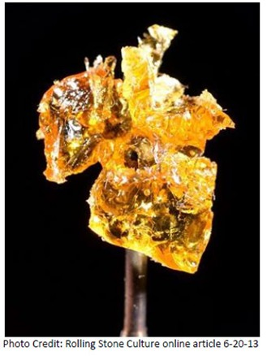
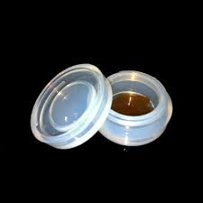
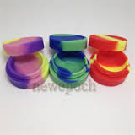
Dabs (Marijuana)
Concentrated to look like honey or wax
Slang terms such as: Ear Wax, Amber, Butane Honey Oil, BHO, Wax, Budder
Pure THC, added to weed
Often stored in what closely
resembles a lip gloss container

Slide 6
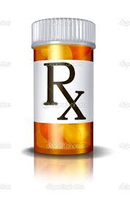
Prescription Pills
Commonly abused Rx Pills: Xanax, Ativan, Oxycontin, Vicodin, Percocet, Adderall, Ritalin, Tylenol with Codeine
Easier to obtain (your own medicine cabinet)
Cheaper
Think less risk for overdosing
Hide/store pills in gum & mint containers , and makeup cases
In 2010, nearly 60% of drug overdose deaths (22,134) involved pharmaceutical drugs. Opioid analgesics (oxycodone, hydrocodone & methadone) were involved in about 3 out of every 4 pharmaceutical overdoses, confirming the predominant role opioids play in drug overdoses. (Source: CDC.gov)

Slide 7
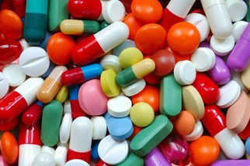
Pharm Parties
Also known as Skittle Parties, Skittling, Trail Mixing and Salad
Mixed colors, in a bowl, looks likes skittles
Usually take 10-15 pills (a handful)
Death
Overdose (seizures, coma)
Breathing problems
Allergic reaction

Slide 8
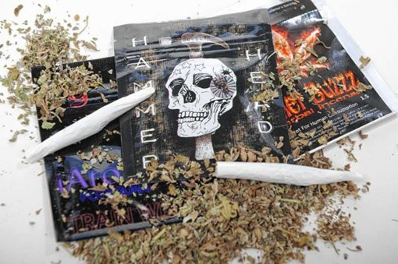
Synthetic Drugs
K-2/Spice, Salvia, Bath Salts
Can cause tremors, hallucinations & seizures
Kids are having seizures smoking this brand

Slide 9
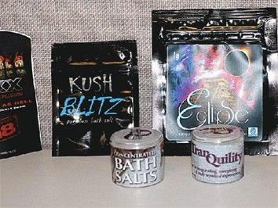
Bath Salts
Have nothing to do with taking a bath!!
Teens are putting bath salts in humidifiers at parties. Some may not even realize what they are inhaling.
Can cause rapid heart rate, sweating, nose bleeds, vomiting, heart attack and stroke

Slide 10
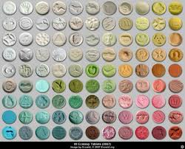
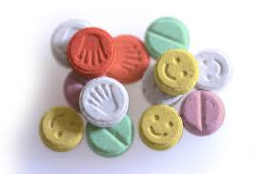
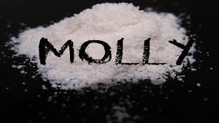
MDMA/Ecstasy
Rave/Club/Concert drug
Molly/MDMA (Purest form)
Causes dehydration and a rise in body temperature, which can lead to death.
Tablets are often made up of other drugs such as methamphetamine, PCP, Codeine, Caffeine, ephedra.

Slide 11
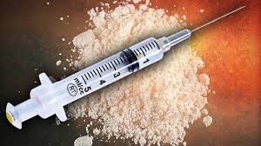
Heroin: An Epidemic
“Buttons” or “Beans” Heroin in a pill form
“Monkey Juice” Heroin in liquid form. Mixing heroin with Visine or other saline solution and putting 2 drops in the eye for a rapid high
“Nasal Spray” Spraying liquid heroin into the nasal cavity
Snorting
Shooting
More potent than ever before
Cheaper
More available
Highly addictive
Easy to overdose

Slide 12
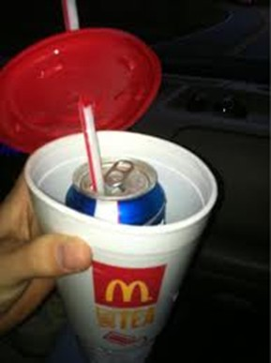
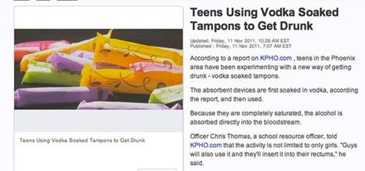
Alcohol
Binge Drinking: Weekend Warrior
Creative and easy ways to conceal it
Enemas: tampons are soaked in alcohol & then inserted into 1 of 2 orifices
Some girls & boys have ended up
in the hospital

Slide 13
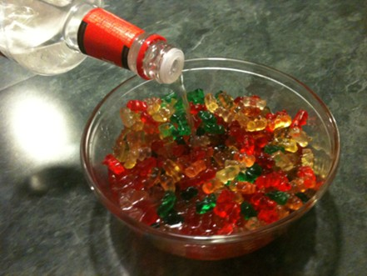
Hard Alcohol Vs. Beer
Hard alcohol is considered to be better, especially among the girls
Less calories, no bloating, get drunk more quickly
Gummy Bears soaked in alcohol

Slide 14
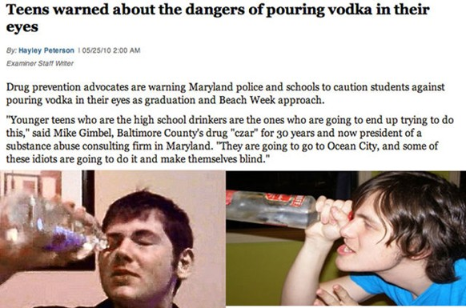
Vodka Eyeballing

Slide 15
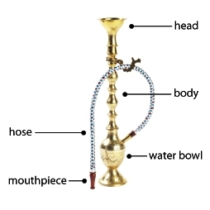
E-Cigs & Hookah
Easily obtained, even available on the internet!
E-Cigs are being used to smoke marijuana
Hookah is just as damaging as cigarettes
Water pipes used to smoke flavored tobacco

Slide 16
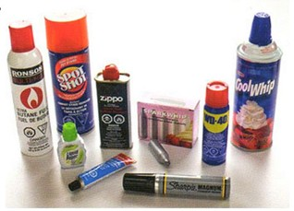
Inhalants
Common Name: Huffing
Can kill after 1st time trying
Rapid pulse, irregular heartbeat, low oxygen
Can cause permanent brain damage
1,000 + everyday items (cool whip, cleaners, white out)
1 in 7 8th graders have tried it (source: monitoring the future.org)
Chronic inhalant abuse = # of heroin users

Slide 17
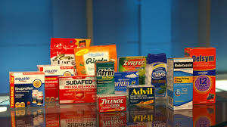
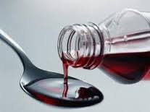
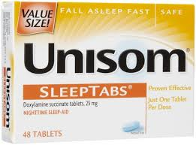
Over the counter meds
Cough Syrup (DXM)
Antihistamines
Decongestants
Diet Pills
Pain Relievers
Sleep Aids

Slide 18
Early Warning Signs
Change in grades or academic performance
Unexplained absences from school
Inappropriate behaviors in school
Dropping out of sports or other activities
Change in friends, hangouts, or sudden avoidance of the “old crowd”
Aggressive, rebellious behavior
Disrespect of parents, family, teachers
Isolating from family members
Denial, lies
Extreme mood swings, rage, anger
Sudden oversensitivity, temper tantrums, irritability or nervousness
Change in overall attitude or personality with no other identifiable cause
General lack of motivation, energy, self-esteem; apathetic attitude
Trouble meeting responsibilities
Symptoms of depression

Slide 19
More Warning Signs…
Sleeping late, unable to get up
Sleeping is class
Paranoia, secretive or suspicious behavior
Hyperactivity, excessive talkativeness
Unexplained need for money/ stealing money or items
Unexplained new clothing or items
Reference to drug acceptance (i.e., posters, clothing, stickers, etc.)
Possession of drug paraphernalia (DO NOT IGNORE THIS! IT DOES NOT BELONG TO A FRIEND!)
Slow or staggering walk
Poor balance
Lack of coordination
Decline in hygiene/physical condition
Tremors or shakes of hands, feet, or head
Slurred speech or rapid fire speech
Slowed reaction time

Slide 20
And Still More…
Confusion, disorientation
Pinpoint pupils, dilated pupils, bloodshot eyes
Sudden weight loss or gain
Chronic runny nose not caused by allergies or cold
Clenching/grinding teeth
Excessive thirst
Red, flushed cheeks or face
Sweatiness
Skin abrasions
Needle marks on arms, legs or bottom of feet

Slide 21
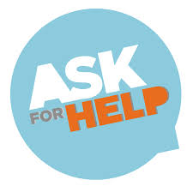
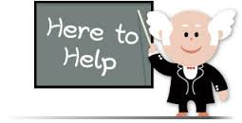
What Can I Do?
YOU know your child! The key is to be tuned into marked changes in behavior, attitude, hygiene, dress, friends, etc.
Do NOT ignore the warning signs: The Best thing that can happen is that you are wrong! The Worst is that you could lose your child to addiction.
Ask for HELP! Ask a school counselor, trusted family member or friend.

Slide 22
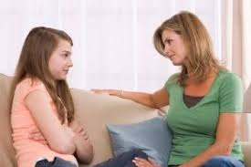
How can I be proactive?
Set reasonable curfews and boundaries
Stay up to “check them out” when they get home
NO sleepovers
Check their phones, computers, Facebook pages, bedrooms, etc.
Get to know their friends
Don’t allow them to drink/host parties in your home
Lock up and monitor prescription meds
TALK TO THEM! Talk about what you learned here tonight more than once! Talk about the dangers of drugs and alcohol. Many are truly unaware of just how harmful these substances can be.
Encourage sports, activities, a job, volunteering, etc. Keep them busy, involved and connected!

Slide 23
Questions & Comments

